Slide 1
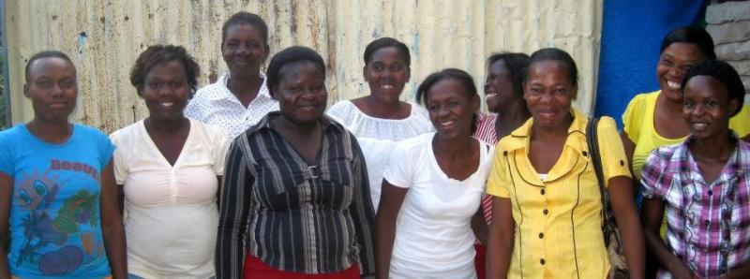
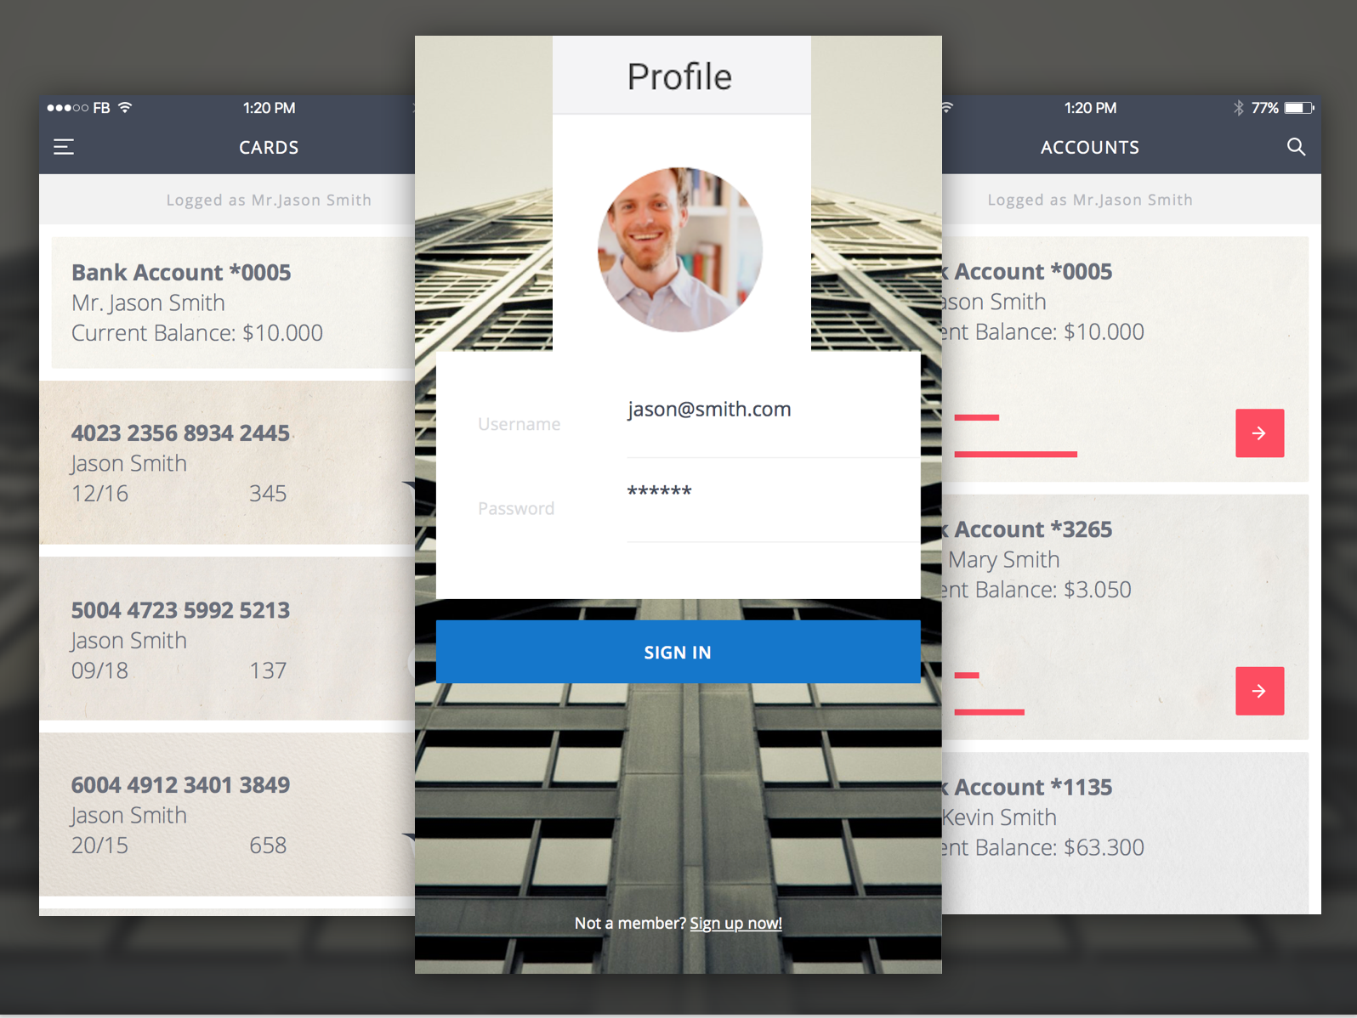
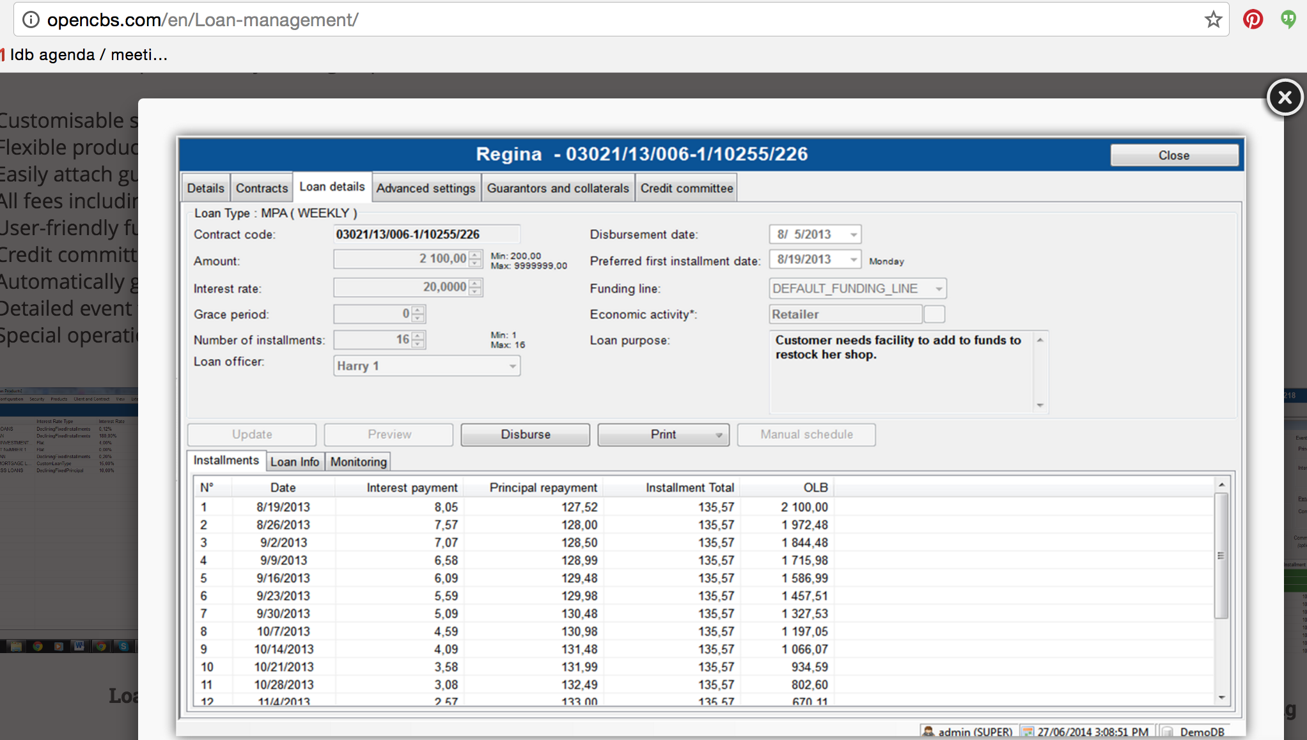
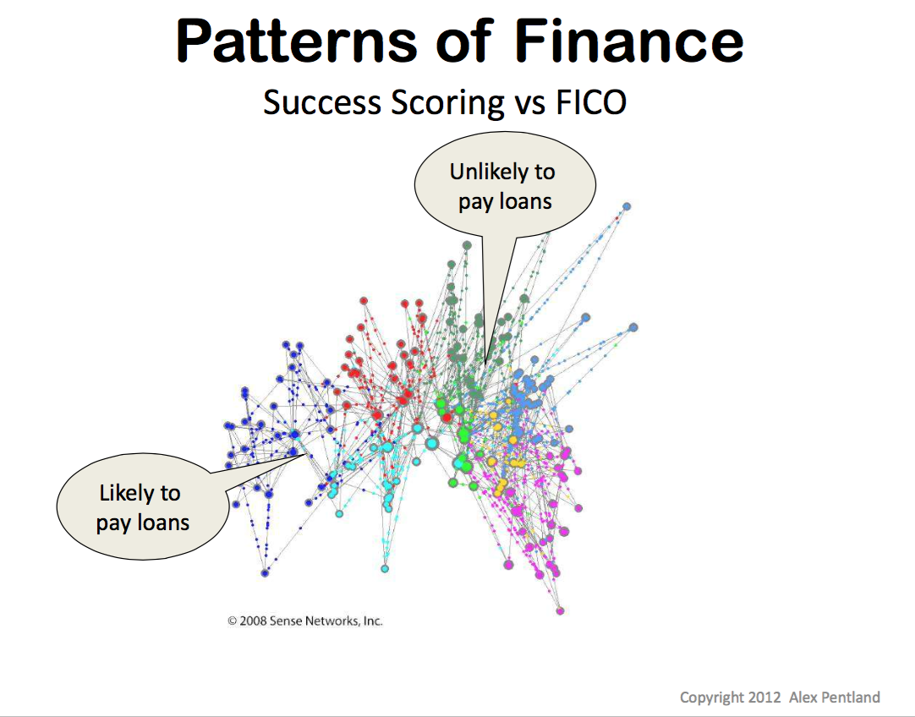
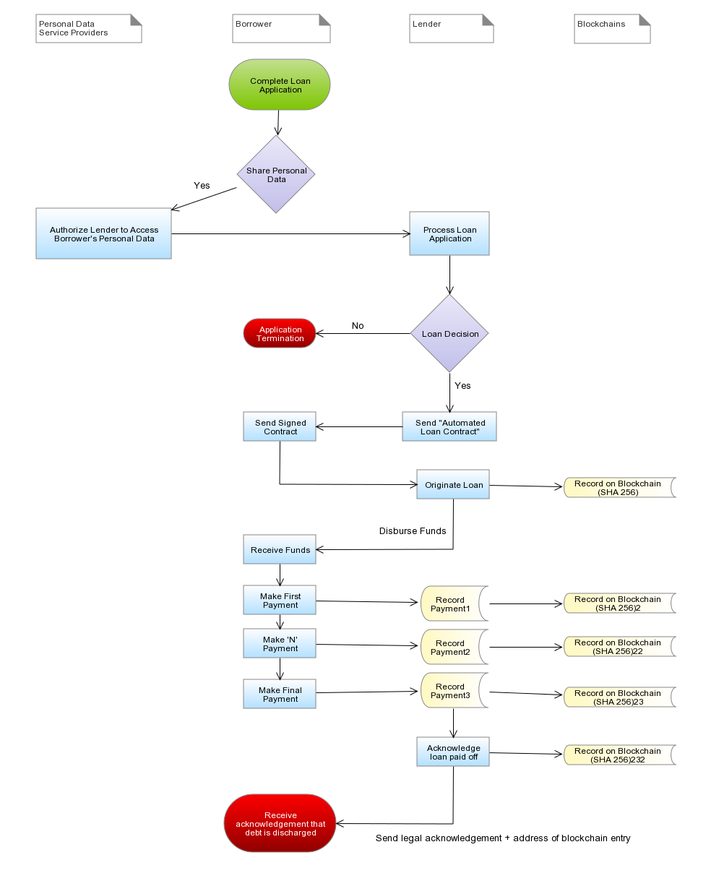
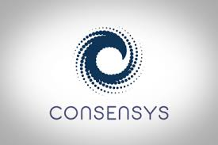
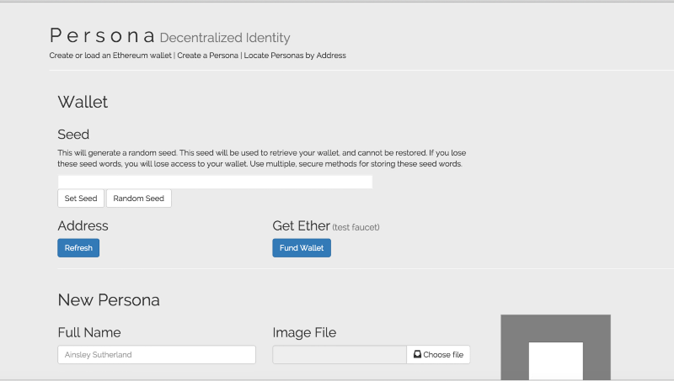
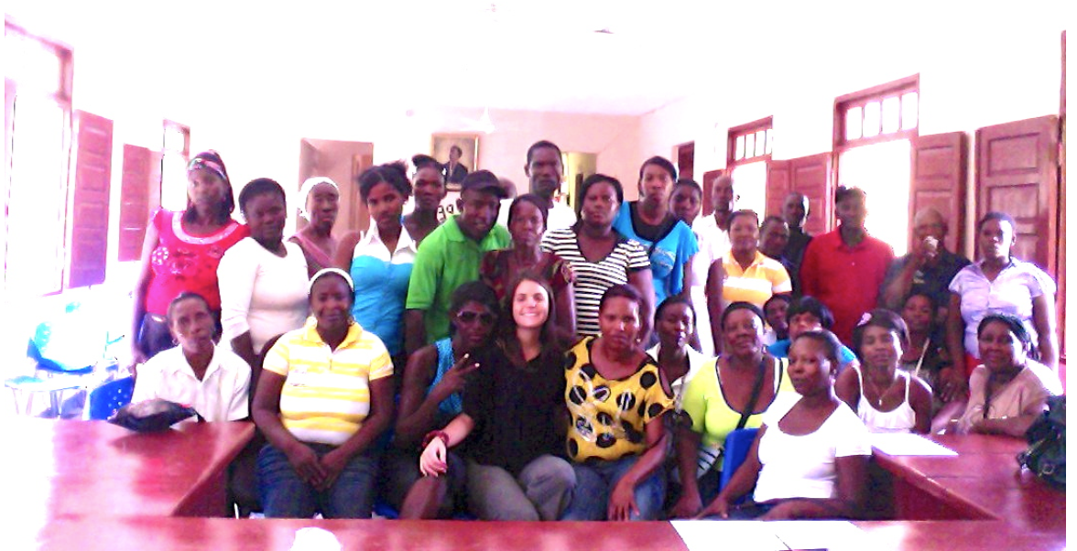
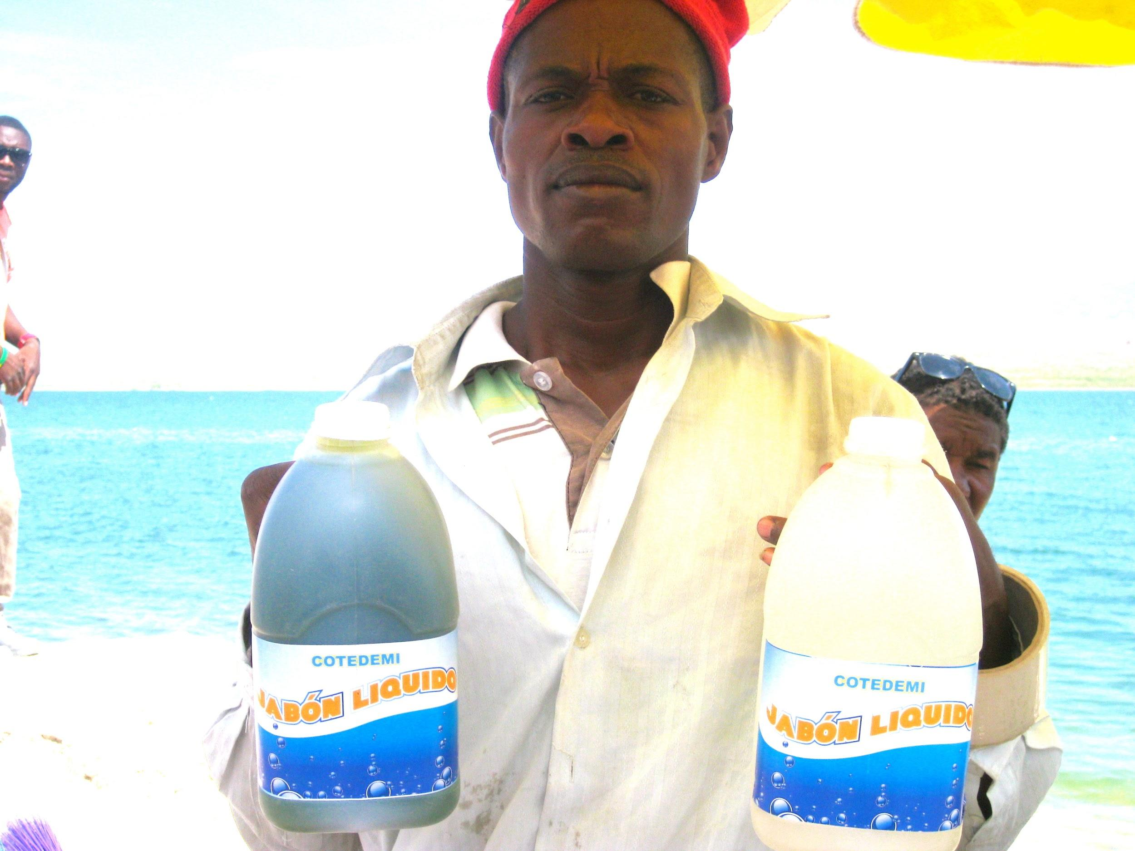
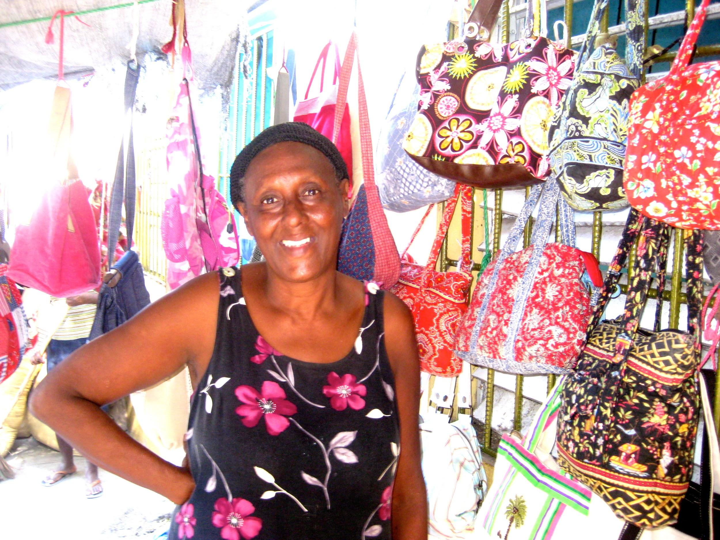
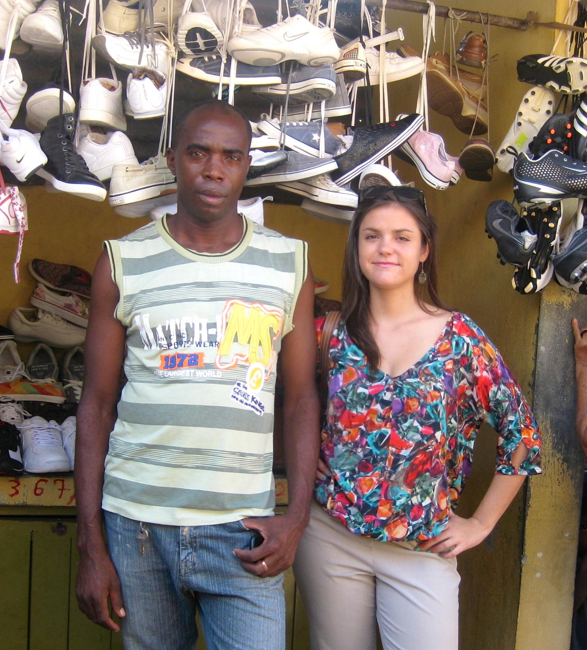
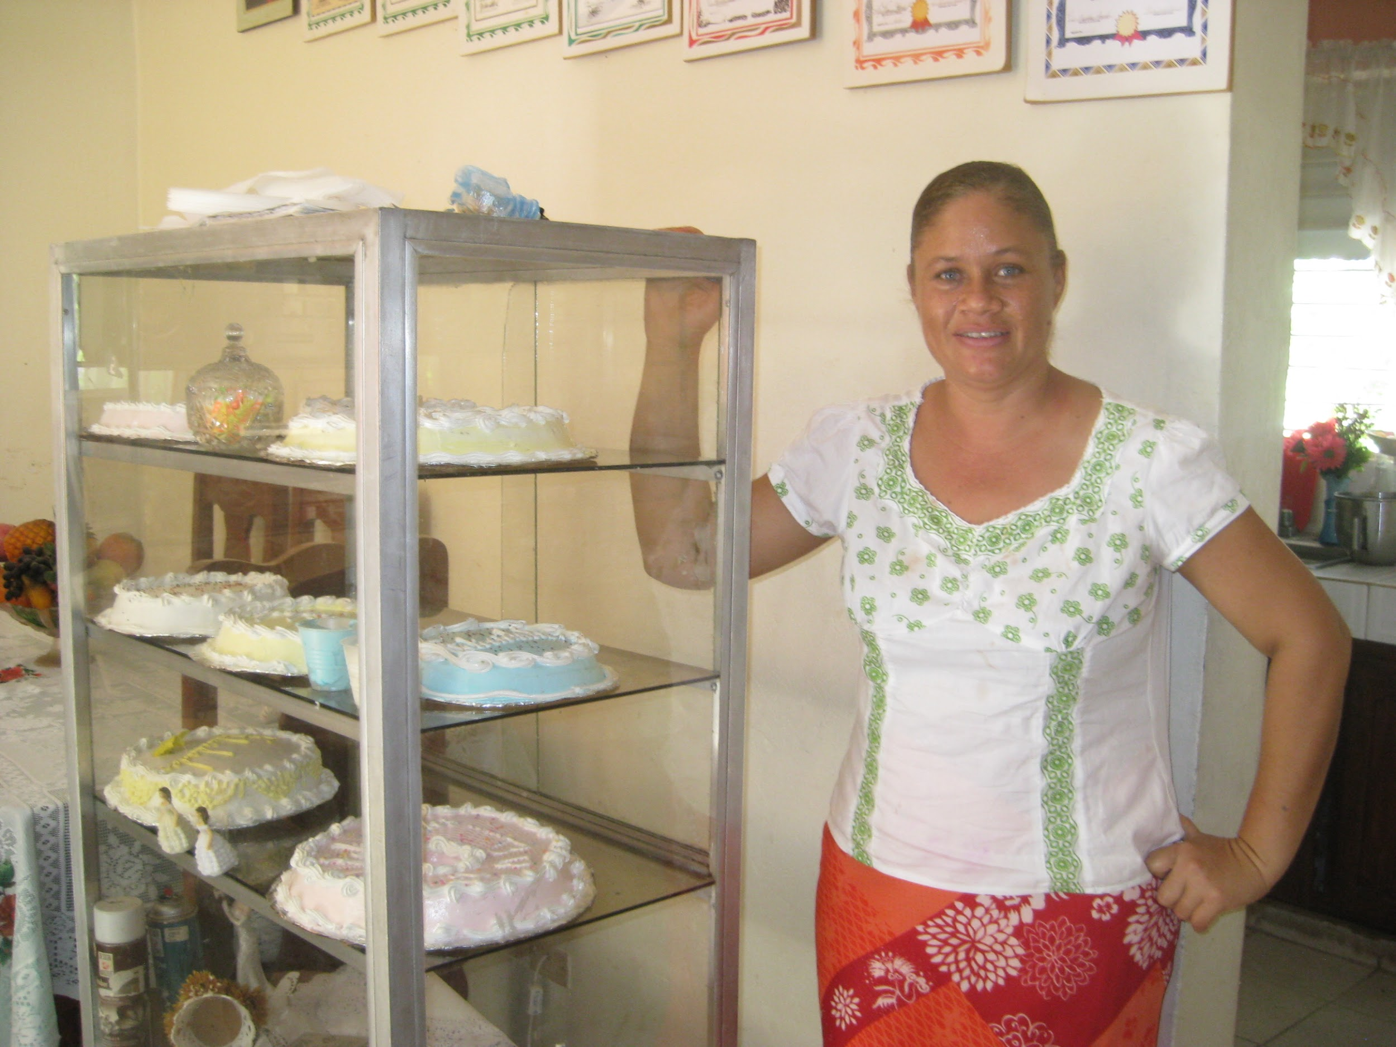
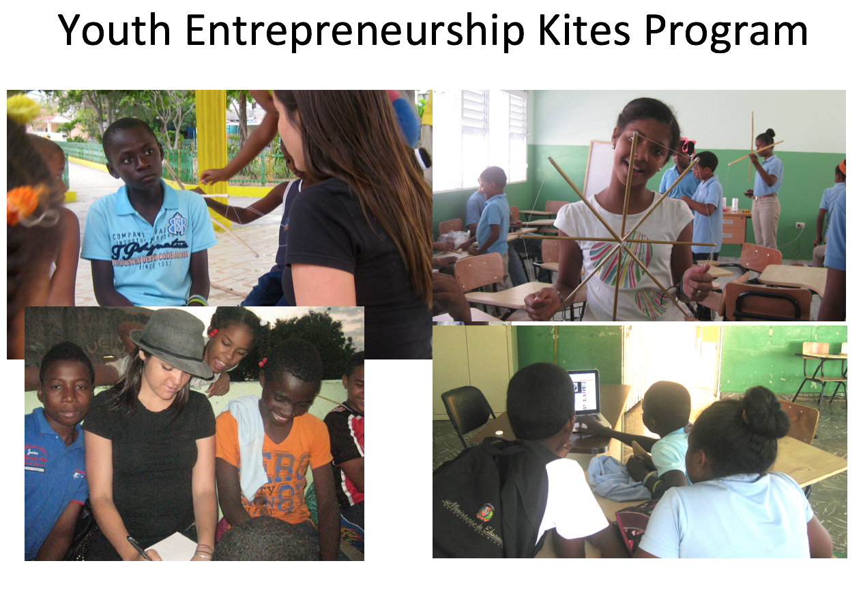
Economic Independence on the Haiti/DR Border
=
Research Objective
To enable individuals and communities to collect and control their own data as an asset class to secure a better economic future
Blockchain Border Bank
Applying data, analytics and blockchain as a solution to the world refugee crisis; to provide better financial services and combat economic instability on the Haiti/DR border.
Building open source products that best fit the needs of Community Banks and Savings Circles. We believe that open access to usable digital (self sovereign) identity will enable refugees and stateless persons to become participating actors in a global economy.
Research Focus Areas
- New Deal on Data: Tools and technology enabling individuals to collect and use their own personal and financial data
- Identity as a Service: Blockchain enabled "self-sovereign" identity for individuals
- Automated Loan Fund: Simplified, streamlined lending to entrepreneurs to develop businesses
- Social Physics: Behavioral and other alternative indicators determining creditworthiness
Left: Banquapp.com Creating an Economic Identity
Right: Opencbs.com - opensource microfinance management software
Sovereign
Identity
Providing reliable identity for individuals as the first step to economic independence
Achieving the UN's goal of providing legal identity to all by 2030 (Target 16.9 of UN SDG)
Leveraging blockchain’s capability to provide secure identity at large scale
Business Development
- Education: Technical training, financial literacy, marketing
- Financial Services: Low interest microloans, product lending, savings
law.MIT.edu/BlockchainBorderBank

